Slide 1

Drone Data Analysis
Data Processing and Visualization Samples
Guada Casuso
Notes:
Additional slide for IoT Hub.

Slide 2
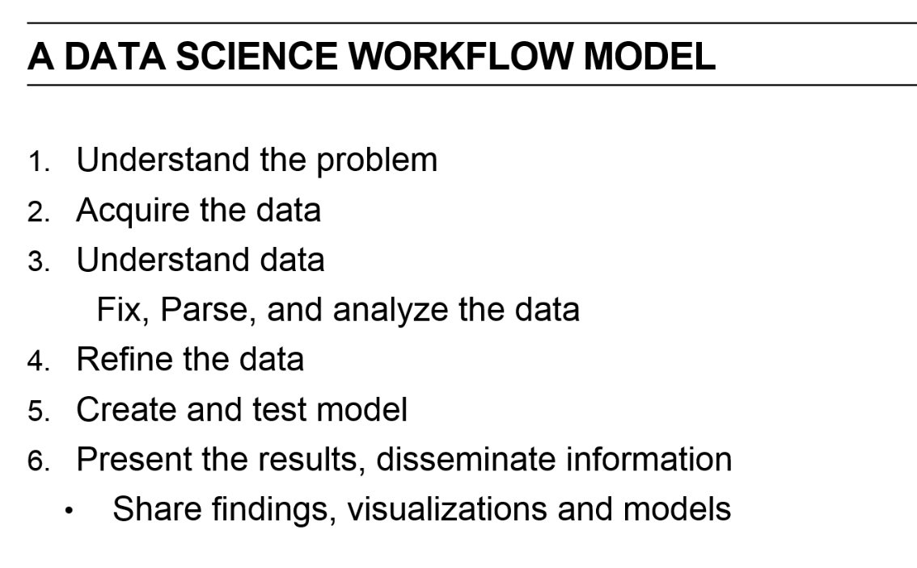

Slide 3
In any autonomous flight mission, the number of UAVs needed to accomplish a mission is very important in order to keep SLA of the Service.
As an example, think about Fire Rescue: several considerations need to be taken to define the right number of units that can perform de Job.
Environmental conditions such as Weather, Season, Territory coverage extension, Altitude, Closeness to the water can influence the Drone Performance.
Drone Data: Battery Capacity, Sensors Information, etc.

Slide 4
First question to answer will be: How many drones do I need in a fleet to accomplish a mission?
A mission can be a fire rescue, a monitoring service, an agriculture scenario, etc.

Slide 5








UAV
Camera
Battery
Real Time Video
Gimbal
Flight Controller
RC
Ground Base

Slide 6






UAS Components
Drone
Sensors: Accelerometer, Giroscope, magno meter, Ultrasound
Ground Base
Thermal / Infrared camera
Cloud Services
Reports
Notes:
Additional slide for IoT Hub.

Slide 7
Acquiring the data
My Data sources will be:
For weather I will use the underground Public Datasource https://www.wunderground.com/weather/api/d/docs?MR=1
The Flight Data that is here and also I will need to add some other measurements such as Battery and Sensors operation.

Slide 8
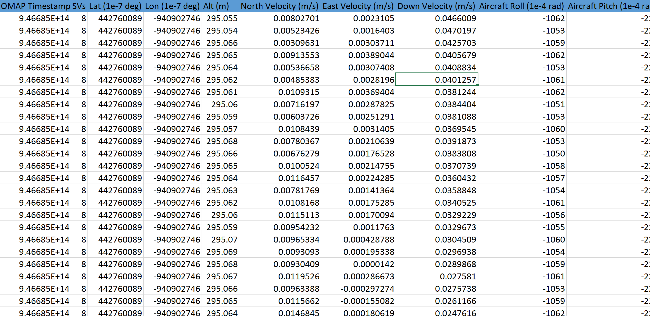
Understanding the Data

Slide 9
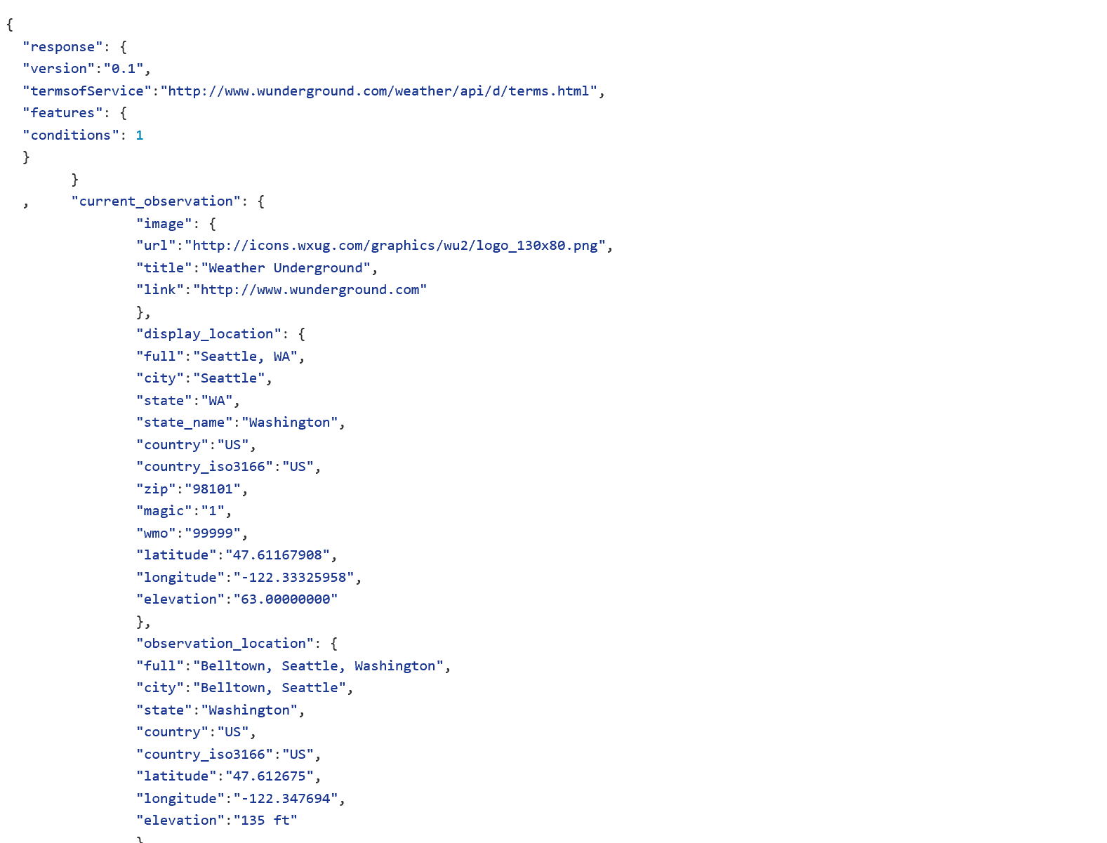
Understanding the Data
http://api.wunderground.com/api/1150673d7b3a40f6/conditions/q/CA/San_Francisco.json
https://github.com/guadacasuso/DroneDataAnalytics/blob/master/Data/SeattleWeather.json

Slide 10
Feature Selection
Season
Location
Equipment
Battery type
-> Time flying
Hectares to cover and Hs of operation vrs #drones

Slide 11
What’s Next?
Refining the Data
Create and Test the Model
Present the Results

Slide 12
